Slide 1

Ordered Dictionaries & Binary Search Tree
Slides are from Ahmed Al-Baghdadi , Kent State University
https://www.cs.kent.edu/~aalbaghd/DAAFall21.html

Slide 2
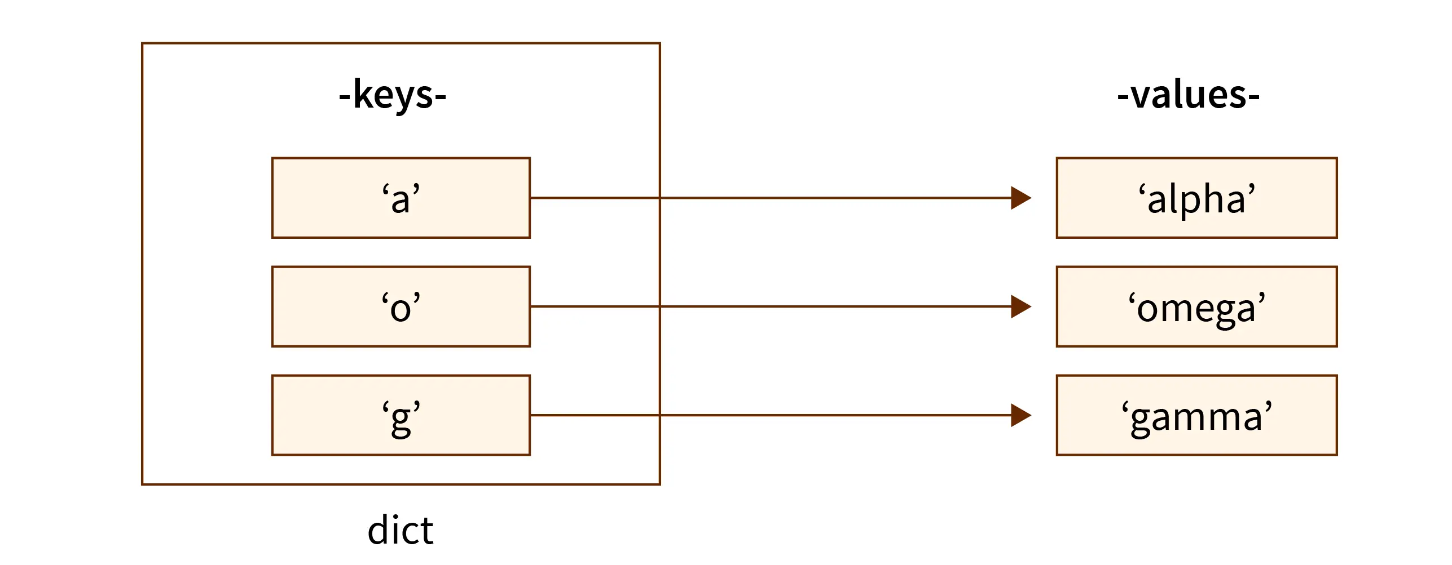
Ordered Dictionaries
A dictionary (also known as a map, hashmap or associative array) is a set of key/value pairs
In word dictionary,
Words are keys and they are sorted
For each key there is a value(meaning of the word)

Slide 3
Ordered Dictionaries
Dictionaries are maintained only based on Keys – Efficiently using Binary Search Tree
Keys are ordered
Perform usual dictionary operations (insertItem, removeItem, findElement) and maintain an order relation for the keys
we use an external comparator for keys
New operations:
closestKeyBefore(k), closestElemBefore(k)
closestKeyAfter(k), closestElemAfter(k)
A special sentinel, NO_SUCH_KEY, is returned if no such item in the dictionary satisfies the query

Slide 4
Binary Search
Items are ordered in a sorted sequence
Find an element k
≤
≤ ≤ ≤ ≤ ≤ ≤ ≤ ≤

Slide 5

Binary Search
Items are ordered in a sorted sequence
Find an element k
– After checking a key j in the sequence, we can tell if item with key k will come before or after it
4 | 8 | 23 | 25 | 29 | 45 | 67 | 78 | 89 | 100
– Which item should we compare against first?
The middle

Slide 6


Binary Search: Find k = 52
Algorithm BinarySearch(S, k, low, high):
if low > high then return NO_SUCH_KEY
mid ← ⌊(low + high) / 2⌋
if key(mid) = k then return elem(mid)
if key(mid) < k then return BinarySearch(S, k, mid + 1, high)
if key(mid) > k then return BinarySearch(S, k, low, mid -1)
low
high
S
0 1 2 3 4 5 6 7 8 9
11 | 18 | 22 | 34 | 41 | 52 | 54 | 63 | 68 | 74

Slide 7

Binary Search: Find k = 52
Algorithm BinarySearch(S, k, low, high):
if low > high then return NO_SUCH_KEY
mid ← ⌊(low + high) / 2⌋
if key(mid) = k then return elem(mid)
if key(mid) < k then return BinarySearch(S, k, mid + 1, high)
if key(mid) > k then return BinarySearch(S, k, low, mid -1)
low
mid
high
S
0 1 2 3 4 5 6 7 8 9
11 | 18 | 22 | 34 | 41 | 52 | 54 | 63 | 68 | 74

Slide 8


Binary Search: Find k = 52
Algorithm BinarySearch(S, k, low, high):
if low > high then return NO_SUCH_KEY
mid ← ⌊(low + high) / 2⌋
if key(mid) = k then return elem(mid)
if key(mid) < k then return BinarySearch(S, k, mid + 1, high)
if key(mid) > k then return BinarySearch(S, k, low, mid -1)
low
mid
high
S
0 1 2 3 4 5 6 7 8 9
11 | 18 | 22 | 34 | 41 | 52 | 54 | 63 | 68 | 74

Slide 9

Binary Search: Find k = 52
Algorithm BinarySearch(S, k, low, high):
if low > high then return NO_SUCH_KEY mid ← ⌊(low + high) / 2⌋
if key(mid) = k then return elem(mid)
if key(mid) < k then return BinarySearch(S, k, mid + 1, high)
if key(mid) > k then return BinarySearch(S, k, low, mid -1)
mid
low high
S
0 1 2 3 4 5 6 7 8 9
11 | 18 | 22 | 34 | 41 | 52 | 54 | 63 | 68 | 74

Slide 10
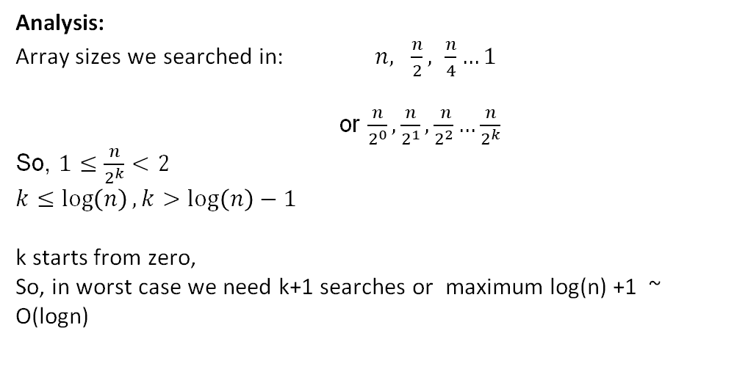
Binary Search
Algorithm BinarySearch(S, k, low, high):
if low > high then return NO_SUCH_KEY
mid ← ⌊(low + high) / 2⌋
if key(mid) = k then return elem(mid)
if key(mid) < k then return BinarySearch(S, k, mid + 1, high)
if key(mid) > k then return BinarySearch(S, k, low, mid -1)
Analysis:
Array sizes we searched in: $n, \frac{n}{2}, \frac{n}{4}…1$
or $\frac{n}{2^{0}},\frac{n}{2^{1}},\frac{ n}{2^{2}}…\frac{n}{2^{k}}$
So, $1≤\frac{n}{2^{k}}<2$
$$k≤\log\left(n\right), k>\log\left(n\right)−1$$
k starts from zero,
So, in worst case we need k+1 searches or maximum log(n) +1 ~ O(logn)
Each successive call to BinarySearch halves the input, so the running time is O(logn)

Slide 11
Lookup Table
A dictionary implemented by means of an array-based sequence which is sorted by key.
why use an array-based sequence rather than a linked list?
Performance:
insertItem takes O(n) time to make room by shifting items
removeItem takes O(n) time to compact by shifting items
findElement takes O(log n) time, using binary search, Linear search Takes O(n)
Effective only for
small dictionaries, or
when searches are the most common operations, while insertions and removals are rarely performed

Slide 12


Binary Search Tree
A binary search tree is a binary tree where each internal node stores a (key, element)-pair, and
each element in the left subtree is smaller than the root
each element in the right subtree is larger than the root
the left and right subtrees are binary search trees
An inorder traversal visits items in ascending order
6
2 9
Inorder traversal:
1 2 4 6 8 9
1 4
8
less than 6
larger than 6

Slide 13
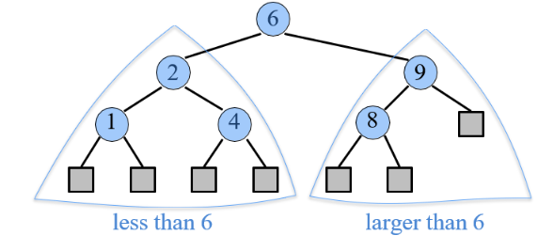
BST – Insert(k, v)
Idea
find a free spot in the tree and add a node which stores that item (k, v)
Strategy
start at root r
if k < key(r), continue in left subtree
if k > key(r), continue in right subtree
Insert at the empty side(left/right)
Runtime is O(h), where h is the height of the tree

Slide 14

BST – Insert Example
Insert the numbers 22, 80, 18, 9, 90, 20.
22

Slide 15

BST – Insert Example
Insert the numbers 22, 80, 18, 9, 90, 20.
80
22

Slide 16


BST – Insert Example
Insert the numbers 22, 80, 18, 9, 90, 20.
18
22
80

Slide 17


BST – Insert Example
Insert the numbers 22, 80, 18, 9, 90, 20.
9
22
18
80

Slide 18


BST – Insert Example
Insert the numbers 22, 80, 18, 9, 90, 20.
90
22
18
80
9

Slide 19


BST – Insert Example
Insert the numbers 22, 80, 18, 9, 90, 20.
20
22
18
80
9
90

Slide 20
BST – Insert Example
Insert the numbers 22, 80, 18, 9, 90, 20.
22
18
80
9
20
90

Slide 21
BST - Find
Find the node with key k
Strategy
start at root r
if k = key(r), return r
if k < key(r), continue in left subtree
if k > key(r), continue in right subtree
If reached to a empty/null side before finding the item, k is not available in the tree, return
Runtime is O(h), where h is the height of the tree

Slide 22



BST – Find Example
Find the number 20
20
22
18
80
9
20
90

Slide 23
BST - Delete
Delete the node with key k
Strategy: let n be the position of FindElement(k)
Remove n without creating “holes” in the tree
Case 1: n has at least one child which is an external node
Case 2: n has two children with internal nodes
Runtime is O(h), where h is the height of the tree

Slide 24
BST – Delete Example
Case 1(a): n has two children which are external nodes
22
18
80
9
20
90
Delete 9

Slide 25
BST – Delete Example
Case 1(b): n has two children which are external nodes
22
18
80
20
90
Delete 9

Slide 26
BST – Delete Example
Case 1: n has a child which is an internal node
22
18
80
9
20
90
Delete 80

Slide 27
BST – Delete Example
Case 1: n has a child which is an internal node
22
18
90
9
20
Delete 80

Slide 28
BST – Delete Example
Case 2: n has two children which are internal nodes
Find the first internal node m that follows n in an inorder traversal Replace n with m
22
Inorder traversal:
9 18 19 20 22 80 90
18
80
Inorder predecessor of 18
Inorder successor of 18
9
20
90
19
Delete 18

Slide 29
BST – Delete Example
Case 2: n has two children which are internal nodes
Find the first internal node m that follows n in an inorder traversal Replace n with m
22
19
80
9
20
90
Delete 18

Slide 30
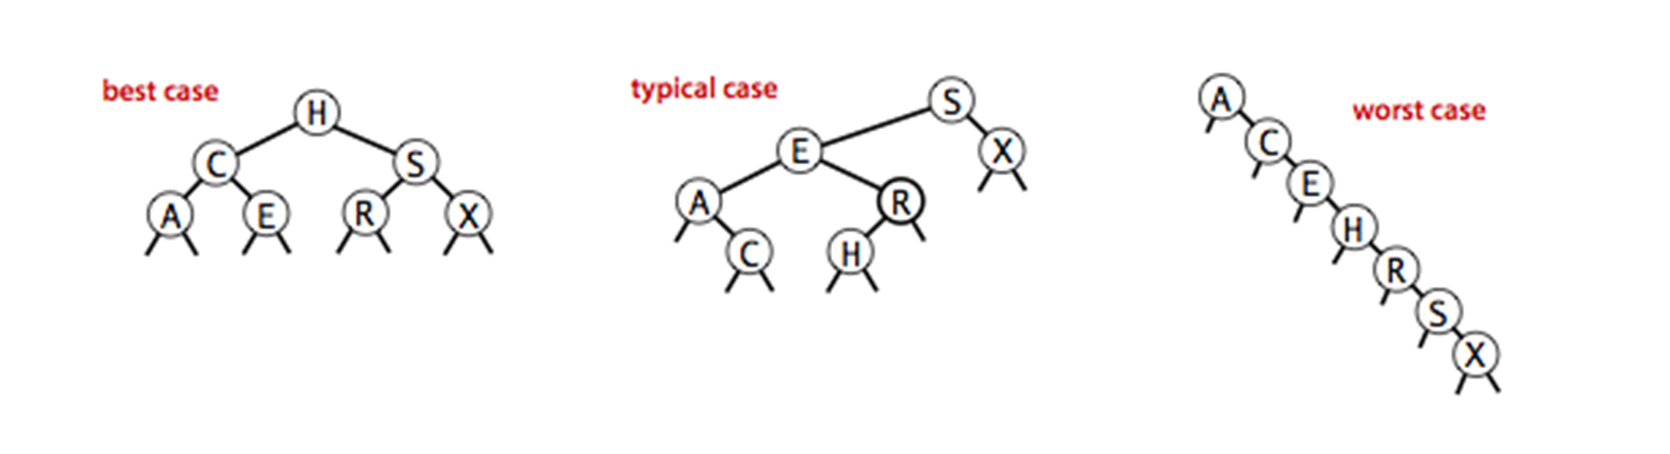
BST Performance
Space used is O(n)
Runtime of all operations is O(h)
What is h in the worst case?
Consider inserting the sequence 1, 2, …, n – 1, n
1
2
n
Worst case height h ∈ O(n).
How do we keep the tree balanced?

Slide 31
Dictionary: Worst-case Comparison
 | Unordered |  | Ordered
 | Log file | Hash table | Lookup table | Binary Search Tree | Balanced Trees
size, isEmpty | O(1) | O(1) | O(1) | O(1) | O(1)
keys, elements | O(n) | O(n) | O(n) | O(n) | O(n)
findElement | O(n) | O(n)** | O(logn) | O(h) | O(logn)
insertItem | O(1) | O(n)** | O(n) | O(h) | O(logn)
removeElement | O(n) | O(n)** | O(n) | O(h) | O(logn)
closestKey closestElem | O(n) | O(n) | O(logn) | O(h) | O(logn)
** Expected running time is O(1)

Slide 32
Other
You are given two sorted integer arrays A and B such that no integer is contained twice in the same array. A and B are nearly identical. However, B is missing exactly one number. Find the missing number in B.
Example:
You are given a sorted array A of distinct integers. Determine whether there exists an index i such that A[i] = i.
A = 4 12 45 67 89 95
B = 4 45 67 89 95

